Slide 1


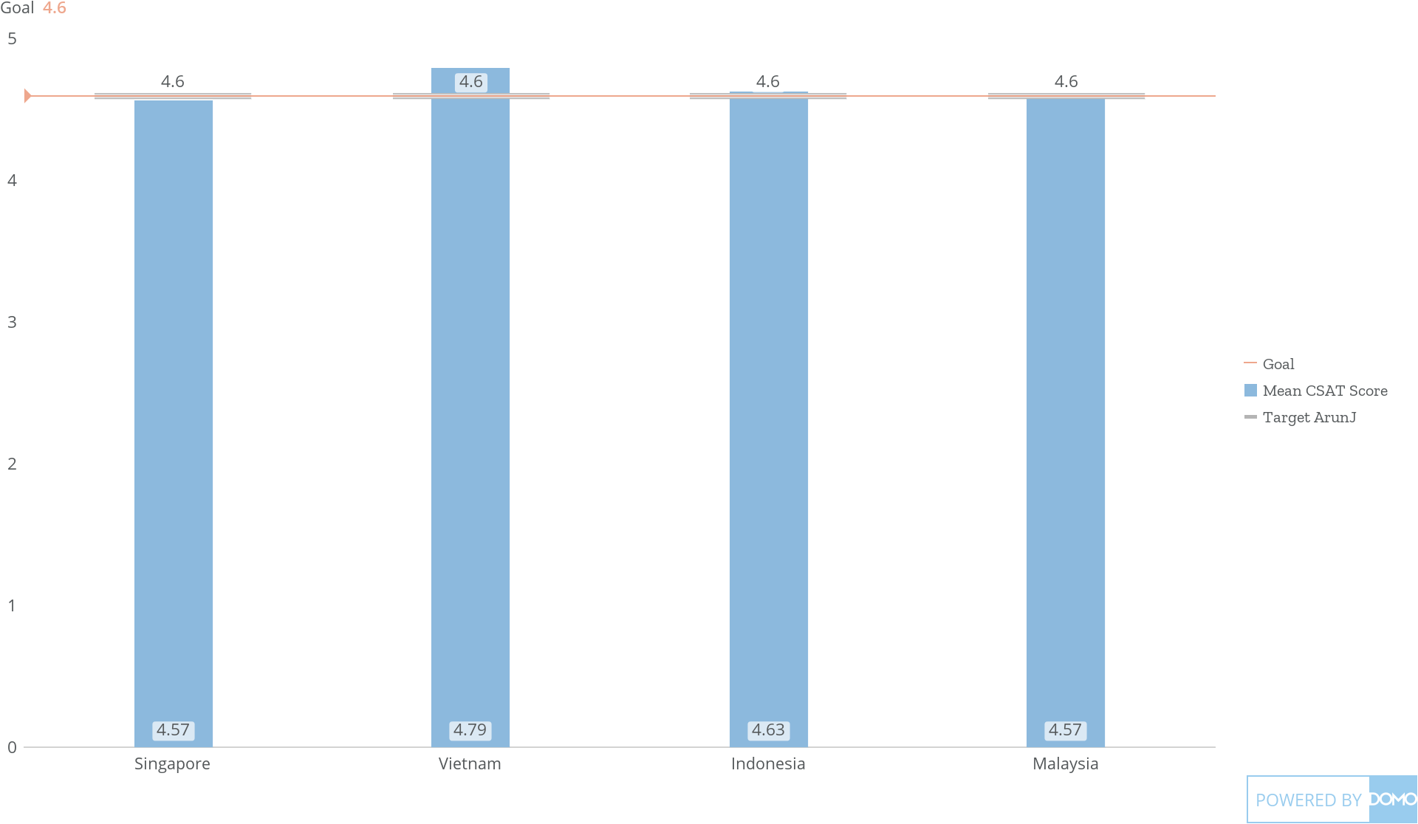
+
exported May 17, 2025, 12:37:00 PM UTC
PE2 | Card 2 | Bonus and Penalty Country Wise
Jan 1, 2023 - Dec 31, 2025
5 Average of Mean CSAT Score

